Slide 1
Annual General Meeting 2024

Slide 2
Annual General Meeting
Welcome to 2024 AGM for the RCEA
The AGM is hybrid event.
Voting is only available for those who are in-person.
However, if there are any objections from on-line, please raised the objection within the chat.
Notes:
Online attendees MUTED

Slide 3
Agenda for the Annual General Meeting
Apologies
Deaths, Resignations and New Members
2023 Minutes
Financial and Membership Report
Chair’s Report
Elections

Slide 4
Apologies
Mervyn Carter
David Hill Smith
Andy Savage

Slide 5
RCEA - Deaths, Resignations & New Members
Deaths, Resignations and New Members
Deceased members
Data since last AGM on 27 April 2024:
No of deaths = 3
No of resignations = 22
No of new joiners = 50
Name | Join Date
Mr H McKenna | 13/10/1999
Mr D J Ayres | 25/07/2012
Mr D J A Hobbs | 12/10/1999
We invite a one-minute silence to reflect on the service of our deceased members

Slide 6
Minutes of the last AGM (1)
RAILWAY CIVIL ENGINEERS’ ASSOCIATION
Minutes of the Annual General Meeting 2023
Held Thursday 27 April 2023.
Apologies for Absence
Apologies were received and noted at the meeting. Apologies and attendees are attached at Appendix A.
Deaths and Resignations
Membership numbers, deaths and resignations were noted as attached at Appendix B.
Minutes of the last Annual General Meeting (28 April 2022)
The minutes from the 2022 AGM were agreed by those present as an accurate record of proceedings.
Proposer – Andrew Boagey
Seconder – Stephen McCormick
Matters Arising
It was agreed that all matters for discussion would be covered under the Chair’s report.
Chair’s Report
The Chair gave a presentation to the AGM. Refer to the attached Chair’s presentation.
Accounts for 2022
The Secretary (Treasurer) presented the end of year accounts at December 2022 to the AGM.
Refer to the attached Secretary’s report as part of the Chair’s presentation.
The accounts for 2022 were agreed by all present.
Proposer – Tim Kendell
Seconder – Malcolm Pearce
It was agreed that there should be no change to the subscription rates for 2024.
Proposer – Bruce Simpson
Seconder – Ralph Bayley
Election of Chair for 2023/24
Stephen McCormick was proposed as Chair for a one-year period..
All those present agreed.
Election of Deputy Chair for 2023/24
Andrew Boagey was proposed as Deputy Chairman for a one-year period.
Proposer – David Coles
Seconder – Tim Kendell
All those present agreed.

Slide 7
Minutes of the last AGM (2)
Any Other Business
Tim Kendell requested that the RCEA acknowledged the contribution of the following Engineers to the Railway Industry. Both Engineers have recently passed away:
Philip Rees OBE – Chief Engineer of BR(GW) from 1976 to 1983
Ken Hayson – Assistant Chief Engineer of Southern
Date of 2024 AGM
Date of 2024 AGM – Thursday 25 April, 5pm.
Election of Secretary for 2023/24
Jian Li Chew was proposed as Secretary (Treasurer) for a one-year period.
All those present agreed.
Election of Management Committee for 2023/24
The following nominees were proposed for election to the RCEA Management Committee:
David Coles, Gabriel Azevedo, Gavin Jessamy, Tom Bates, Bruce Simpson.
All those present agreed.
Election of Membership Secretary for 2023/24
Chris Wheeldon was proposed as Membership Secretary for 2023/4.
All those present agreed.
Appointment of Examiners
Simon Blanchflower and Andy Savage were proposed as Internal Examiners for 2023/24.
All those present agreed.
2023/24 Programme
Details of forthcoming events are published on the RCEA website.
Appendix A
Apologies to the AGM are listed below:
Bill Pilkington
Andy Savage
Martyn Back
David Hill Smith
Simon Blanchflower
Member Attendees
Jonathan Gammon
Tim Kendell
Ralph Bayley
Tony Roberts
Malcolm Pearce
Bruce Simpson
Lewis Cawte
Committee Members
Jonathan Buttery
Jian Li Chew
Andrew Boagey
David Coles
Chris Wheeldon
Stephen McCormick
On-Line Attendees
Paul Evans
Carlo Borri
Chris Hyde

Slide 8
Minutes of the last AGM (3)
Appendix B
Category No
Graduate & Students 9
Honorary 26
Retired 69
Standard 286
Young Professional 17
Total 40
Membership data as at 5/4/2023
Number of deceased members since last AGM = 6
Mr AMJ Wood – joined 1999
Mr JW Doidge CEng MICE
Mr DH Stuckey – joined 1999
Dr WJ Harvey BSc PhD CEng FICE MIStructE – joined 2004
Mr I R Clough CEng MICE – joined 1999
Mr RW Collingwood BSc CEng FICE – joined 1999
Resignations since last AGM = 4
New members since last AGM = 32

Slide 9
Minutes of the last AGM
Proposer
Seconder

Slide 10
Agree the minutes of the last AGM
Yes
No

Slide 11
Financial and Membership Report
Presented by:
Jian Li Chew, Honorary Secretary (Treasurer)

Slide 12
2023 Performance
 | Forecast | Actual
Income | £5,940 | £6,776
Expenditure | £10,636 | £9,529
Surplus/(deficit) | (£4,695) | (£2,752)
Balance on 31 Dec 2023 | £26,246 | £27,280
Factors behind difference in forecast budget and actual finances:
Subscription income £166 higher than forecast due to increase in membership.
Increase in the ICE bank account’s interest rate, producing £932 in interest income compared to the forecast of £262.
Expenditure on committee and events £944 lower than forecast.
Expenditure on admin charges £131 lower than forecast.

Slide 13
2024 Forecast
Income: £ 7,159 (Membership fees and interest)
Expenditure: £10,547 (High estimate of events expenses)
Deficit: (£ 3,389)
End-of-year Balance: £23,892
Forecast allows for:
April 2024 Annual Seminar and AGM
Jan, Jun, Oct and Nov 2024 vents outside London, accounting for venue hire, refreshments and committee members’ travel and accommodation costs
Feb, May and Sep 2024 events in ICE London
Dec 2024 Christmas Social
Online management committee meetings

Slide 14
Long-term financial sustainability
Current membership fees are ~35% of historic levels, and were lowered in 2021 to account for COVID impact.
Current reserves very sustainable, but fees likely to need to rise in the near future due to return of in-person events and events held outside of London.
RCEA Committee to keep track of income and expenditure. Propose that £20,000 is the level below which a warning is sounded.

Slide 15
Sensitivity analysis of membership fee income
Member type | No.(*) | 35% level |  | 45% level |  | 50% level |  | 65% level |  | 100% level
 |  | Fee | Sub-total | Fee | Sub-total | Fee | Sub-total | Fee | Sub-total | Fee | Sub-total
Student | 18 | 0.00 | 0.00 | 0.00 | 0.00 | 0.00 | 0.00 | 0.00 | 0.00 | 0.00 | 0.00
Honorary | 23 | 0.00 | 0.00 | 0.00 | 0.00 | 0.00 | 0.00 | 0.00 | 0.00 | 0.00 | 0.00
Retired | 62 | 5.50 | 341.00 | 7.25 | 449.50 | 8.00 | 496.00 | 10.50 | 651.00 | 16.00 | 992.00
Standard | 315 | 18.50 | 5,827.50 | 24.75 | 7,796.25 | 27.50 | 8,662.50 | 35.75 | 11,261.25 | 55.00 | 17,325.00
Young Person | 32 | 8.75 | 280.00 | 11.25 | 360.00 | 12.50 | 400.00 | 16.25 | 520.00 | 25.00 | 800.00
TOTAL |  |  | 6,448.50 |  | 8,605.75 |  | 9,558.50 |  | 12,432.25 |  | 19,117.00
Treasurer recommends that any future membership fee increase shall be to the 45% level.
(*) Total number of members table is the forecast membership for 2024, not the actual membership.

Slide 16
Proposer to 2023 Accounts
Proposer
Seconder

Slide 17
Agree the 2023 accounts
Yes
No

Slide 18
RCEA Membership (April 2024)
Graduate & Student | 2023 9
Honorary | 26
Retired | 69
Standard | 286
YP | 17
Total | 407
2024 15
23
65
304
23
430
Change +6
-3
-4
+18
+6
+23
Notes:
16 New Members, 6 Resignations

Slide 19
RCEA Membership Fees
Graduate Membership
Graduate Member of the ICE (GMICE) or meet equivalent requirements.
£8.75 for year 2023
Ordinary Membership
Member or Fellow of the ICE (MICE or FICE) or satisfy RCEA as to suitability.
£18.50 for year 2023
Retired Members
Open to all retired professionals.
£5.50 for year 2023
Student Member of ICE
Free

Slide 20
Proposer to 2024 Membership Fees
The Committee asks the AGM to agree that the membership subscription renewal fees for 2024 will remain at the current level.
The Honorary Secretary (Treasurer) has proposed that due to the healthy reserves of the RCEA, that there is no current need to review the fees.
This will be reviewed again next at the 2025 AGM.
Proposer
Seconder

Slide 21
2024 Membership Fee Proposal
Yes
No

Slide 22
Chairperson’s Report
Presented by:
Steve McCormick, Chairperson

Slide 23
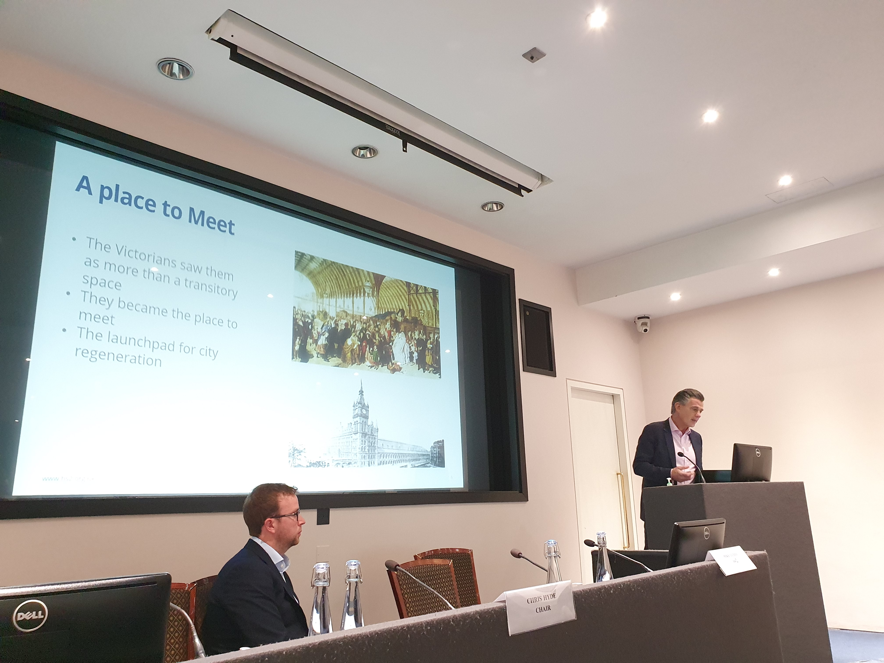
Chairpersons Report 2024
Strategy:
Going forward, ICE have cut meeting room availability for RCEA at GGS by 50%, from 10 to 5. These cuts don’t just affect RCEA and are a result of reduced in-person attendance and success of hybrid events.
RCEA have responded to this by increasing number of meetings in the regions.
RCEA have also introduced lunch and learn sessions in response to members who stated that we needed to look at different days and times rather than the usual Thursday evening meetings.
AGM Review
Membership Numbers
Range of Events
Committee

Slide 24
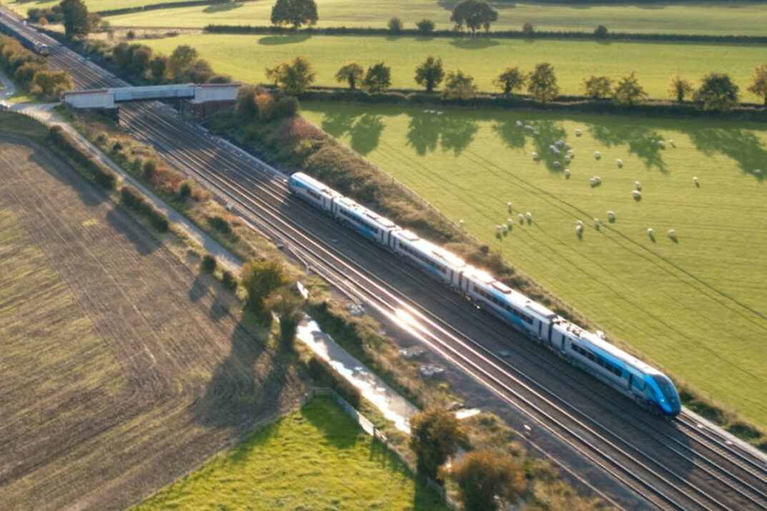
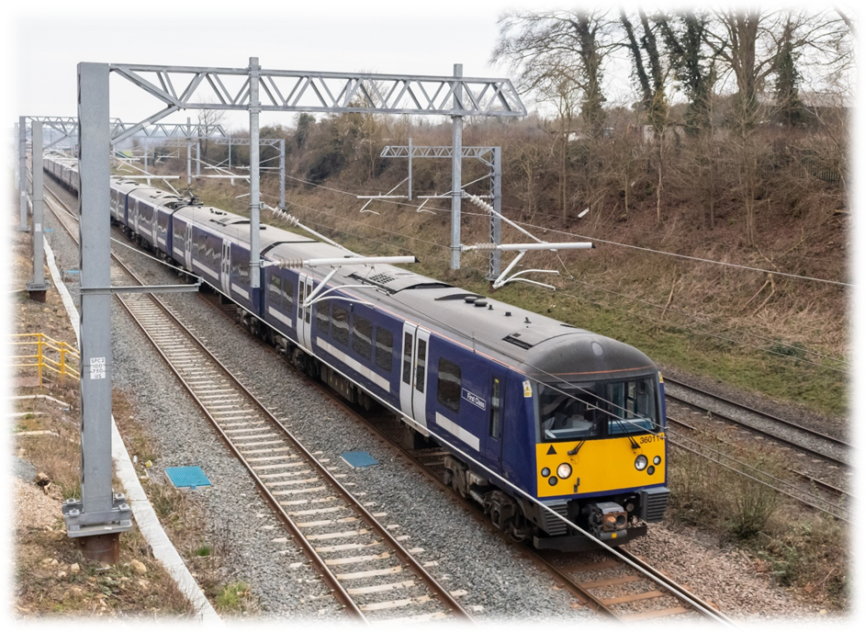
RCEA Events held in 2023-2024
25 May 2023 - York
Transpennine Route Upgrade – East of Leeds: On Track to Better
22 June 2023 - London
Affordable Electrification: Reducing the Amount of Civil Engineering Required

Slide 25
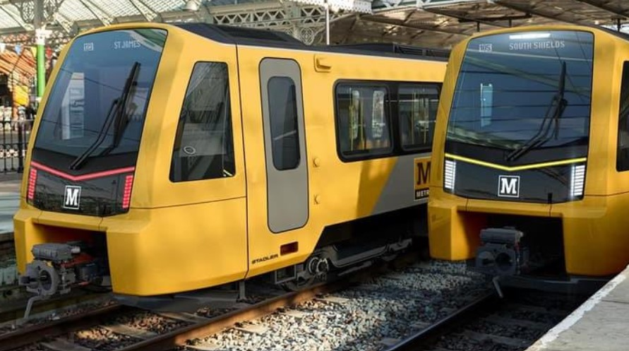
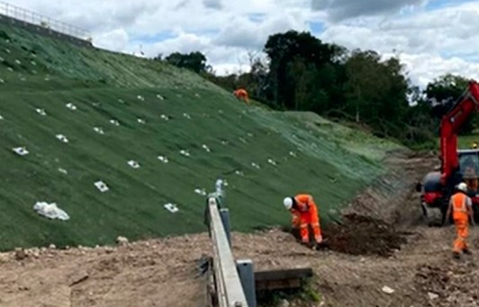
RCEA Events held in 2023-2024
20 September 2023 - York
Reopening and Derationalising the North East’s Railways
26 October 2023 - London
Hook Emergency Embankment Scheme: Geotech Delivery

Slide 26
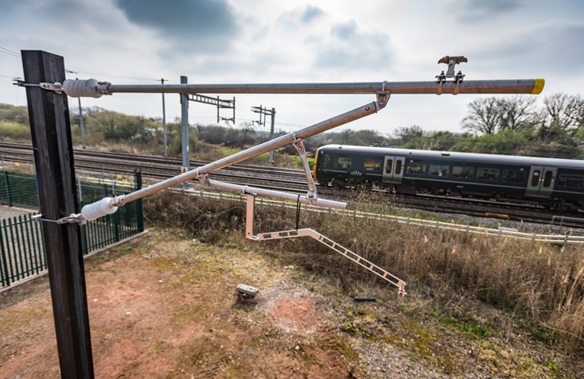
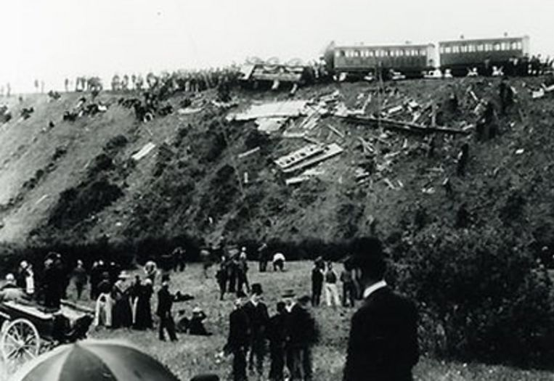
RCEA Events held in 2023-2024
23 November 2023 - London
Innovations in Low Carbon, Low-Cost Design: Composites in Rail Electrification
5 December 2023 - London
Safety Never Stops – 200 years of Safety on the Railway

Slide 27
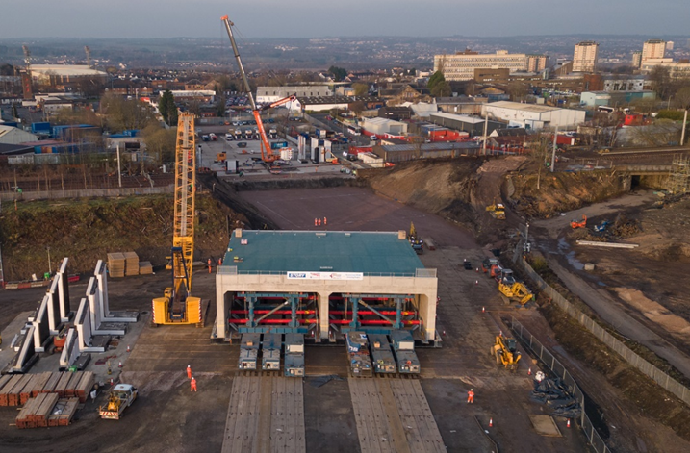
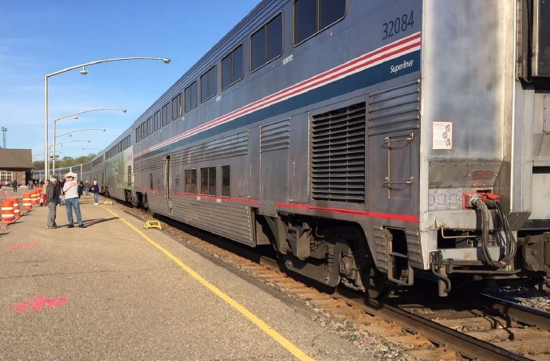
RCEA Events held in 2023-2024
25 January 2024 - Glasgow
Installation of the 5,000t Ravenscraig Rail Bridge
22 February 2024 - London
US Railroad Station Design: What do you Think?

Slide 28
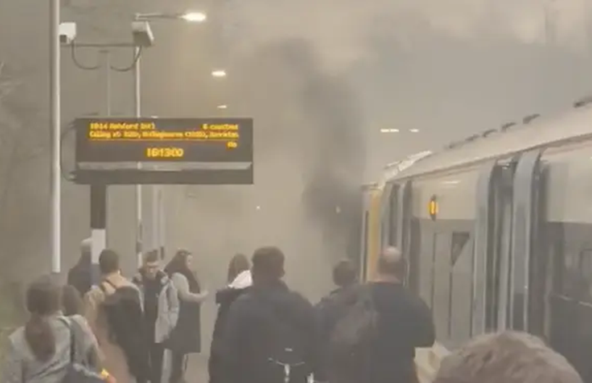
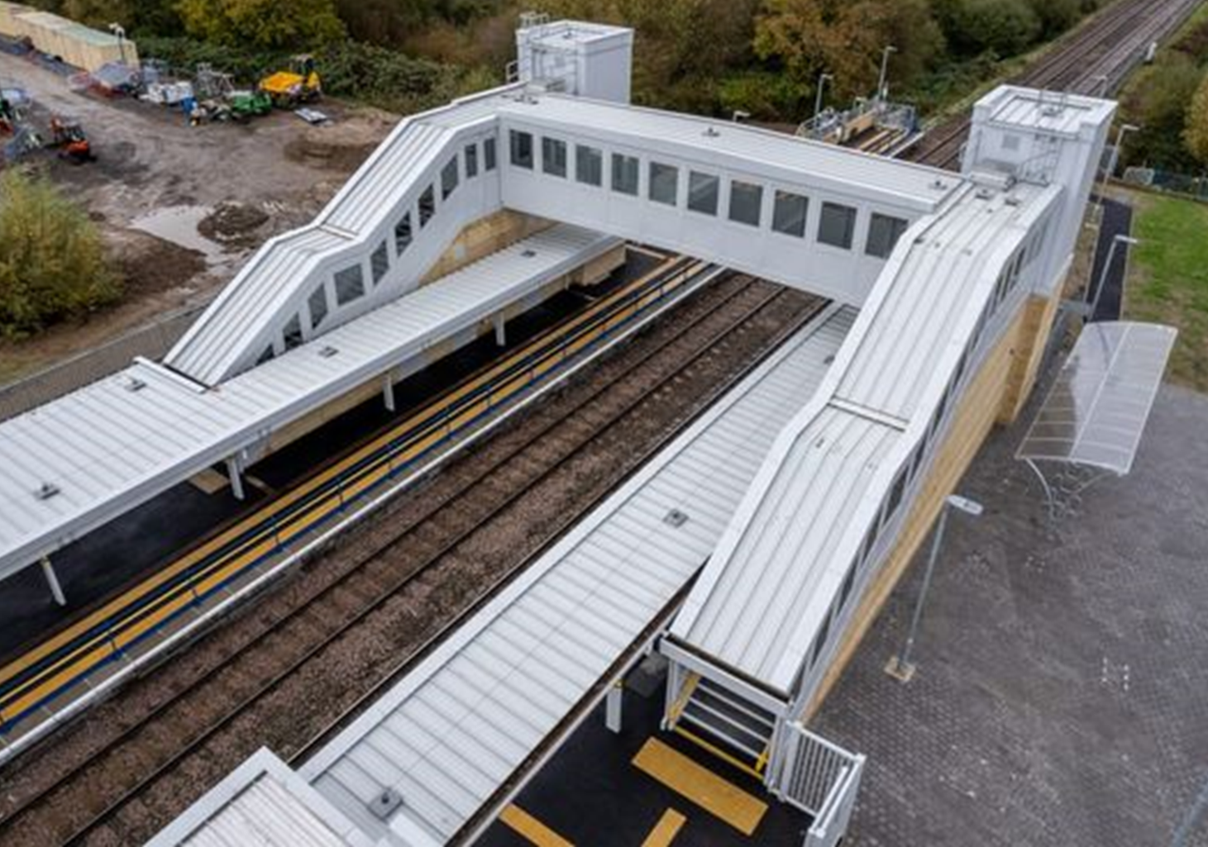
RCEA Events held in 2023-2024
12 March 2024 – Lunch and Learn
Approach to Fire Safety Design for Station Schemes
9 April 2024 – Lunch and Learn
Tactile Paving in Stations

Slide 29
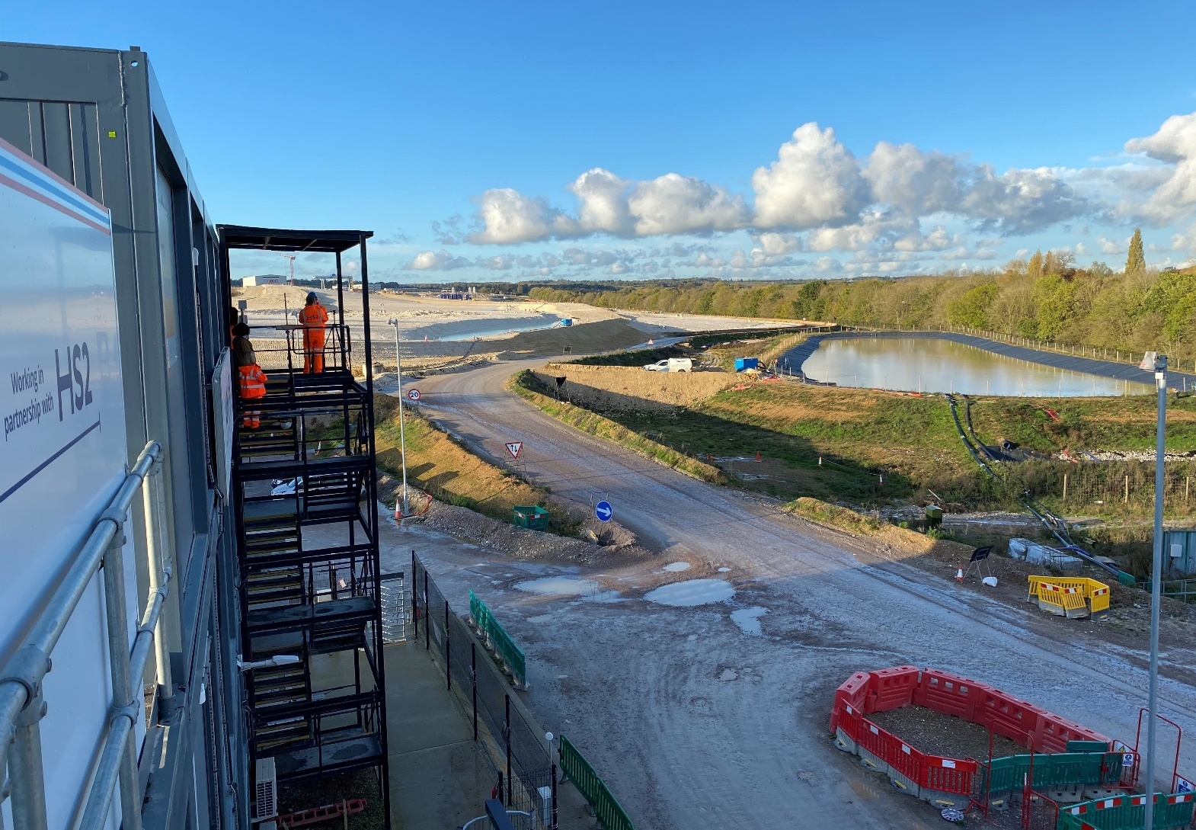
RCEA Events held in 2023-2024
25 April 2024 – London
RCEA Annual Conference: Environmental Challenges for Major Transport Infrastructure Projects

Slide 30
Elections – 2024/25
Chair
Deputy Chair
Honorary Secretary
Committee
Membership Secretary
Examiners

Slide 31
Nominations from the floor?

Slide 32
Agree to elect Steve McCormick to Committee Chair for 2024/25
Yes
No

Slide 33
Unfortunately, we gave not received any nominations for Deputy Chair for 2024/25. Do we have any nominations from the floor?
Yes
No

Slide 34
Agree to elect Jian Li Chew to Honorary Secretary for 2024/25
Yes
No

Slide 35
Agree to elect the following to the Management Committee for 2024/25 David Coles, Tom Bates, Bruce Simpson
Yes
No
Notes:
ALSO 2 CO-OPTED MEMBERS: ALI AHMED (Graduate, Costain) and STEVE McCORMICK onto committee. (ONLY NEED VOTE FOR 6 STATUTORY PLACES)

Slide 36
Agree to appoint Chris Wheeldon to Membership Secretary for 2023/24
Yes
No

Slide 37
Agree to appoint Simon Blanchflower and Andy Savage as External Examiners for 2023/24
Yes
No

Slide 38
Any Other Business?

Slide 39
Thank you…
See you at next meeting and at AGM next year… April 2025

